Slide 1


Cyber threat analysis
Submitted By:
Name : N. Chaitanya Reddy
Registration Number : 12216546
Section :K22UN
Roll Number : 45

Slide 2
Table of Contents
Introduction
Problem statement
Solution approach and Abstract
Methodology
Result and analysis
Conclusion
Reference

Slide 3
1.Introduction
Exploratory Data Analysis (EDA) is important in helping us understand and work with complex retail data in this project. By using EDA, the dataset used in this analysis is related to cybersecurity threats and vulnerabilities and comprises X rows and Y columns. It includes a wide range of attributes that help in identifying and analysing various cybersecurity incidents, such as attack patterns, software types, vulnerabilities, and threat classifications. The key objective of this analysis was to conduct exploratory data analysis (EDA) to uncover meaningful patterns, trends, and correlations between these variables, which could potentially inform better security practices and detection strategies.
The dataset covers diverse categories such as software, vulnerabilities, attack types, and other threat-related information. With the growing complexity of cyberattacks and vulnerabilities in modern IT environments, understanding the relationship between different data points can significantly aid in threat detection and mitigation strategies. The analysis aims to provide insights that could help organizations strengthen their defenses and respond more effectively to emerging threats.

Slide 4
2.Problem Statement
The project aims to analyze a comprehensive Cyber Threat Intelligence dataset containing detailed information on vulnerabilities, such as CVE IDs, severity ratings, and recommended actions. Using hypothesis testing and multivariate analysis, the study identifies key patterns and relationships between features to understand the evolving cybersecurity landscape. Techniques like correlation analysis, Principal Component Analysis (PCA), and chi-squared tests are applied to reduce dimensionality and validate statistical assumptions. The findings provide actionable insights into the nature of cyber threats and vulnerabilities, supporting enhanced decision-making in cybersecurity strategies.

Slide 5
3.Abstract
This project analyzes a Cyber Threat Analysis to identify patterns and insights into vulnerabilities, including severity ratings, CVE IDs, and mitigation strategies. Using statistical techniques such as hypothesis testing, correlation analysis, and Principal Component Analysis (PCA), the study explores feature relationships, reduces dimensionality, and validates findings. The results highlight significant trends in cybersecurity threats and vulnerabilities, offering actionable insights to enhance decision-making and improve cybersecurity measures.

Slide 6
4.Methodology
Data Collection and Preprocessing:
The dataset, containing CVE IDs, severity ratings, and mitigation strategies, was cleaned and structured for analysis.
Exploratory Data Analysis (EDA):
Conducted EDA to understand feature distributions, identify correlations, and detect outliers.
Hypothesis Testing:
Formulated null and alternative hypotheses to test relationships between key features. Applied t-tests, chi-squared tests, and ANOVA for validation.

Slide 7
4.Methodology
Multivariate Analysis:
Correlation matrices and Principal Component Analysis (PCA) were used to analyze feature interactions and reduce dimensionality.
Visualization and Insights:
Leveraged visualizations (heatmaps, pair plots) to present relationships, clusters, and patterns in the data.
Conclusion:
Derived actionable insights to inform cybersecurity risk mitigation strategies.

Slide 8
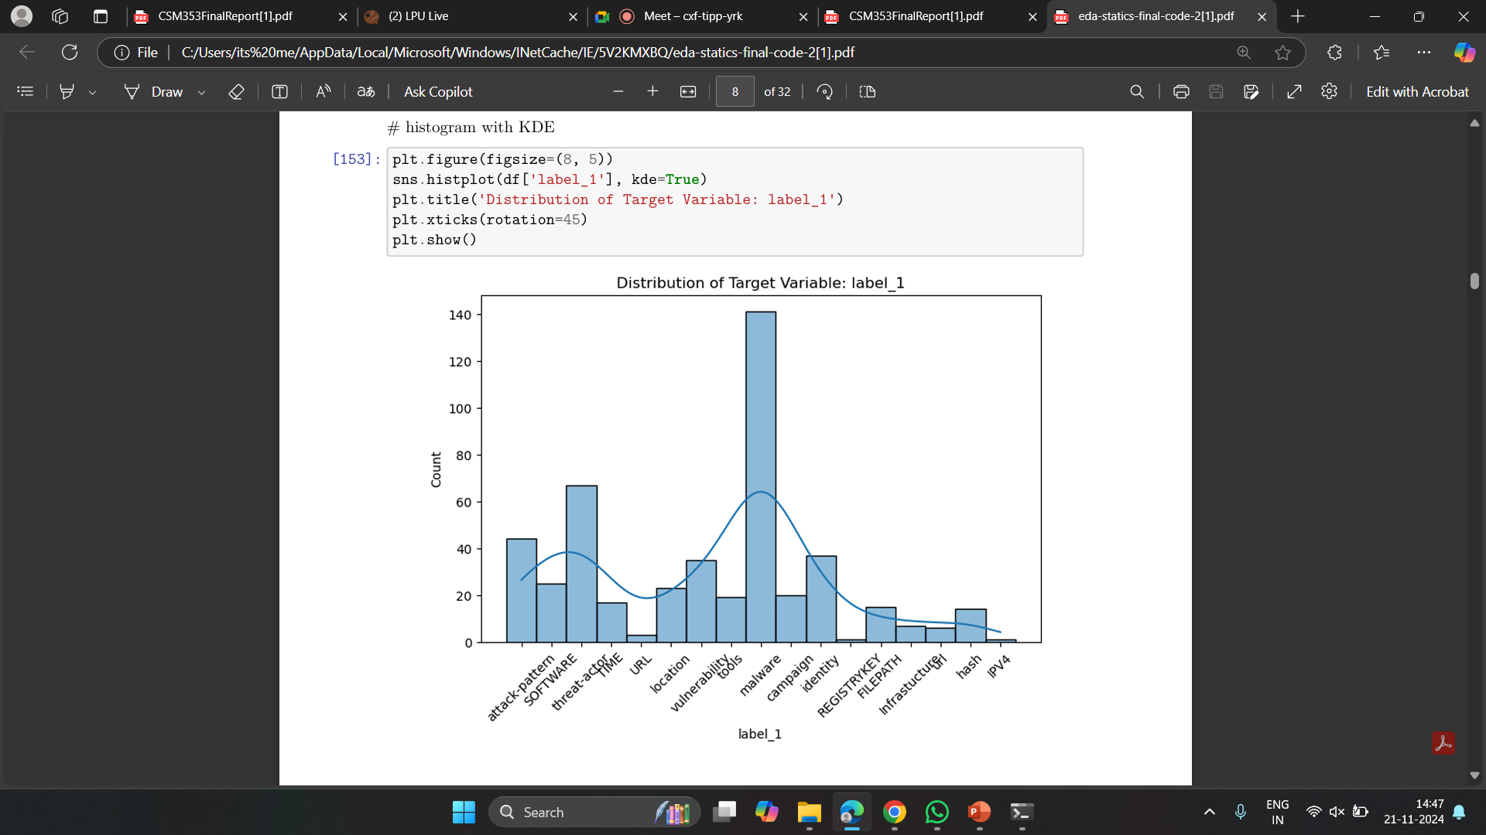
5.Result and Analysis
1.Bar Chart
Analysis: histogram with a KDE plot showing the distribution of the target variable 'label_1'

Slide 9
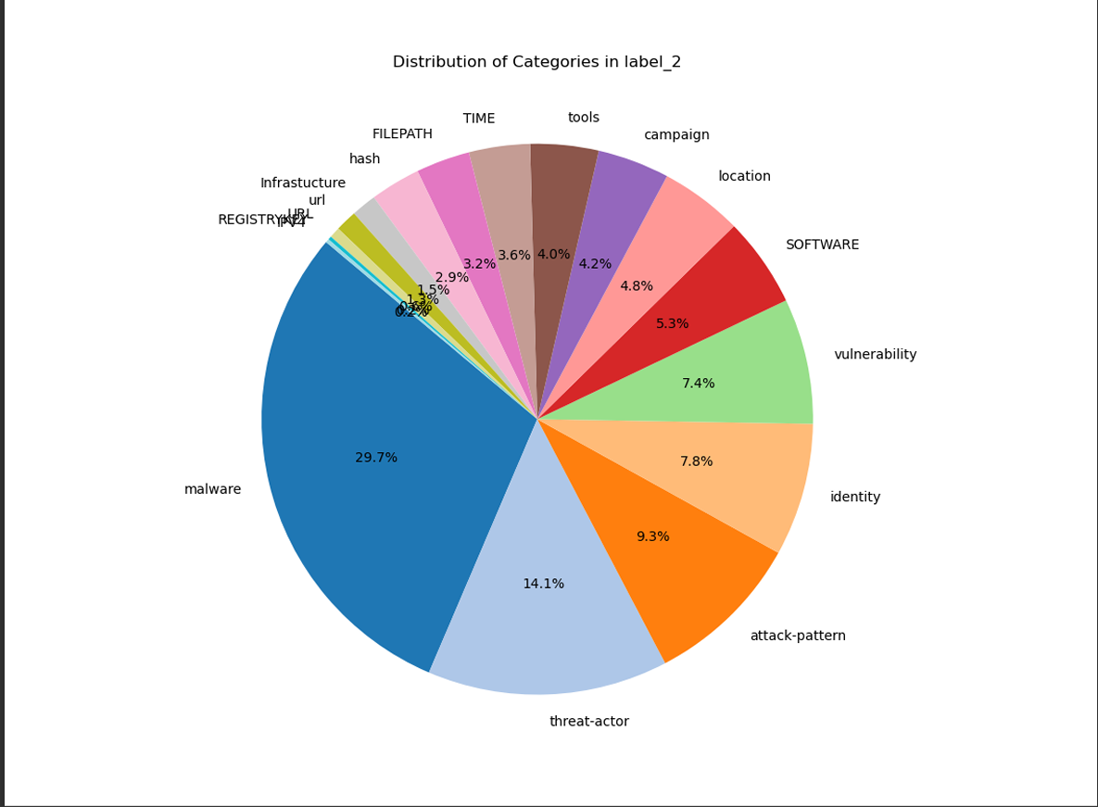
Result and Analysis
2.Pie Chart
Analysis: Distibution of categories

Slide 10
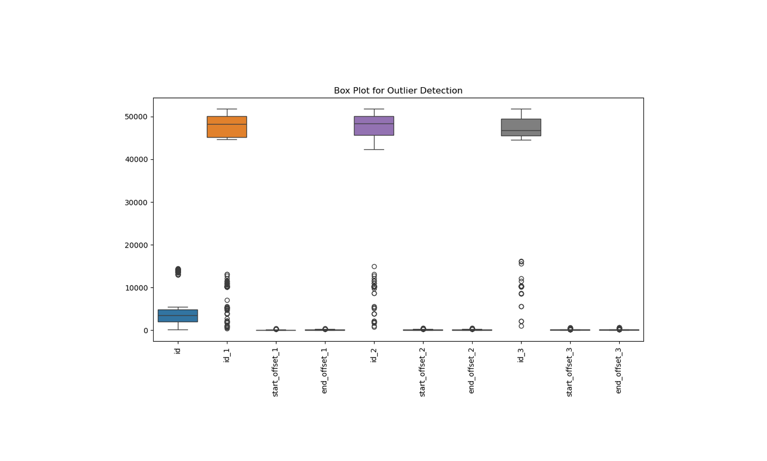
Result and Analysis
3.Box plot
Analysis: Box plot for outlier detection

Slide 11
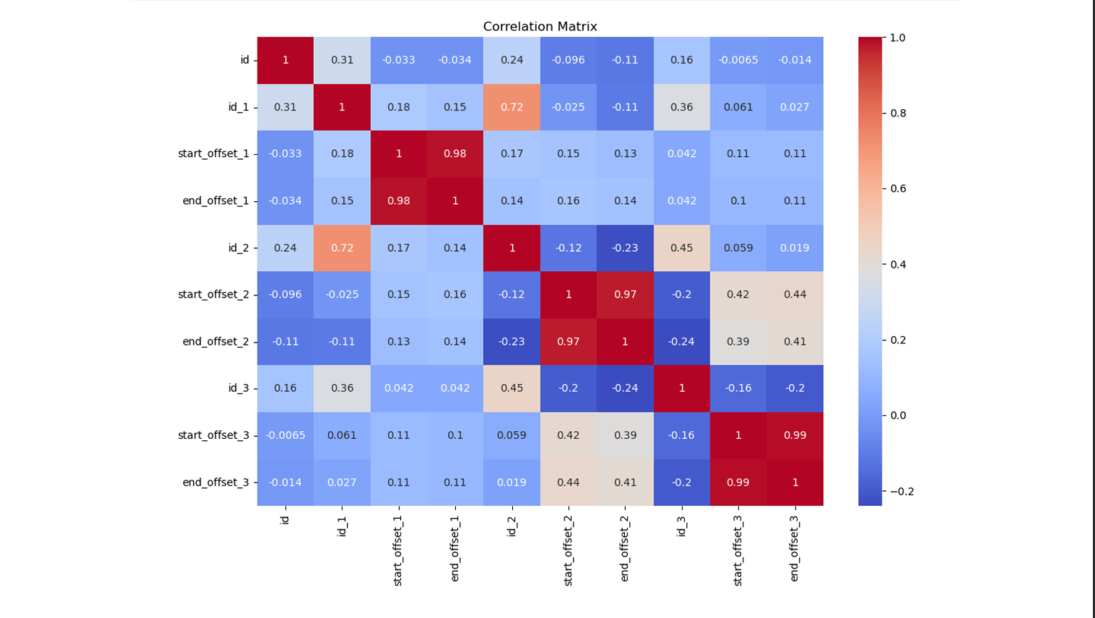
Result and Analysis
4.Correlation Matrix
Analysis output: The image shows a correlation matrix heatmap that visualizes the relationships between different variables. Strong positive correlations are marked in red, and negative correlations in blue. For example, "start_offset_1" and "end_offset_1" exhibit a strong positive correlation (~0.98), while other variables like "id" and "start_offset_3" show minimal correlation (~0). This helps identify multicollinearity and key relationships for further analysis.

Slide 12
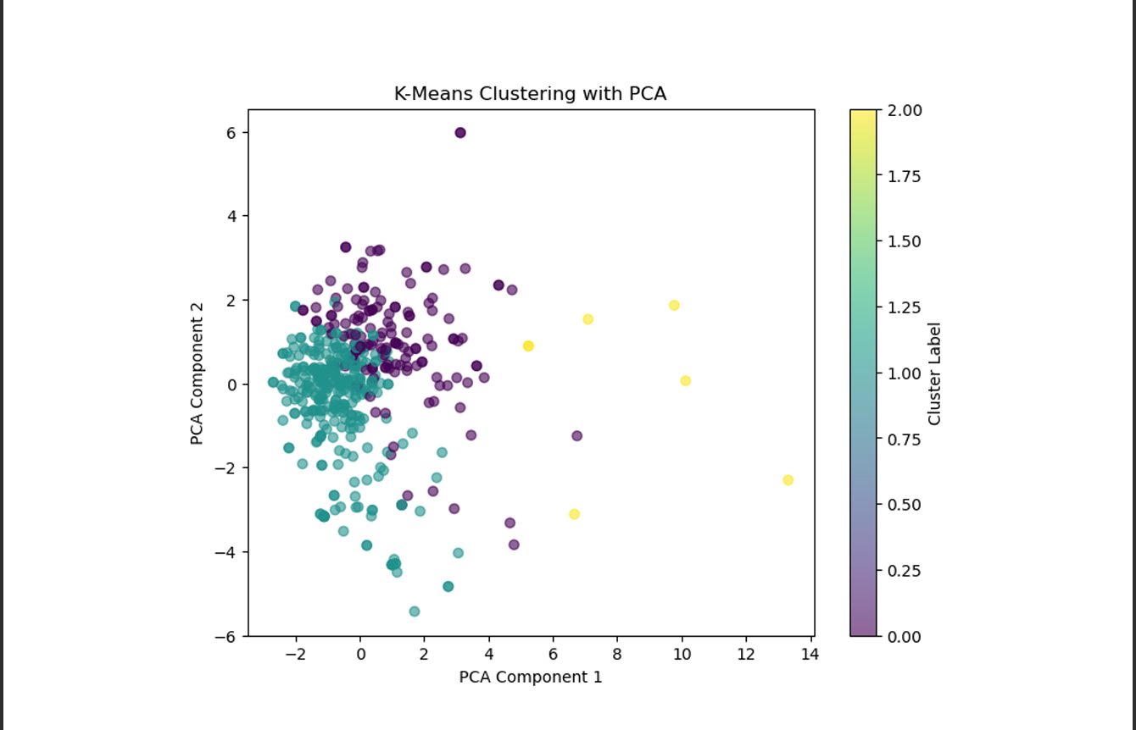
Result and Analysis
5. K-means Clustering with pca
Analysis output: The image shows the results of a K-Means clustering algorithm applied to data that has been reduced to two dimensions using Principal Component Analysis (PCA). The three clusters are represented by different colors, with each point representing a data point.

Slide 13
6.Conculsion
The analysis provided valuable insights into the dataset's underlying patterns, showcasing the distribution of key variables and their relationships. The histogram with KDE highlighted the distribution of the target variable, offering a clear understanding of the data's composition. The correlation matrix identified significant relationships between variables, helping to uncover potential dependencies and patterns critical for decision-making. These findings contribute to understanding cybersecurity threats, enabling better detection, prediction, and mitigation strategies, and demonstrating the importance of exploratory data analysis in identifying actionable insights from complex datasets.

Slide 14
7.Reference
1.Dataset has been taken from Kaggle.
Source Name: Cyber Threat Intelligence Dataset on Kaggle
2. Cybersecurity and Infrastructure Security Agency (CISA) –
Publishes advisories, updates on critical vulnerabilities, and recommended security actions. Website: CISA Vulnerability Advisories
3. National Vulnerability Database (NVD).
Website: National Vulnerability Database (NVD)

Slide 15


